Slide 1

Radiology AI Pro

Slide 2

CONTENTS
01
Project Overview
04
Our Solution
02
Problem Statement
05
Team & Vision
03
User Impact

Slide 3

01
Project Overview

Slide 4
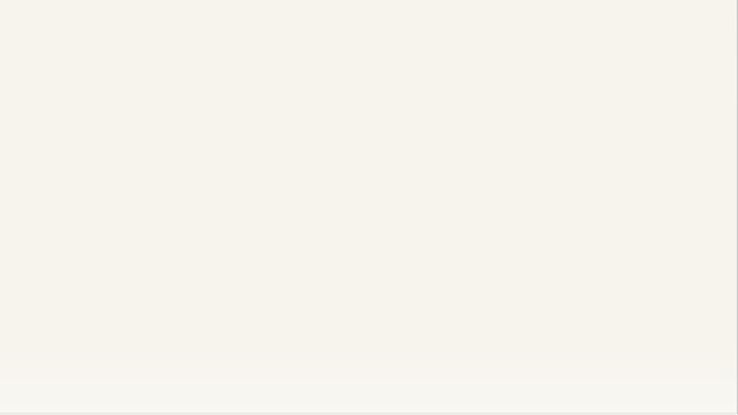
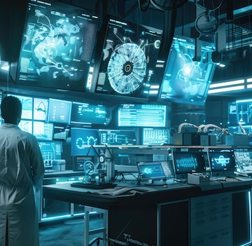
Radiology AI Pro
An AI-powered radiology assistant delivering preliminary scan interpretation and structured medical reports . It accelerates workflows in emergency and low-resource settings without replacing radiologists.
Automatic scan type detection (X-ray, CT, MRI, Ultrasound)
AI-generated findings & clinical-style formatted report
Confidence score & safety disclaimer
PDF export for seamless workflow integration

Slide 5
02
Problem Statement

Slide 6
The Radiology Bottleneck in India
A critical shortage of specialists and surging imaging demand are crippling diagnostic timelines.
Severe Shortage
High Imaging Load
Critical Impact
A critical lack of radiologists, especially outside major cities, creates vast diagnostic deserts.
Manual interpretation is time-consuming and error-prone, leading to backlogs and delayed treatment.
Slow workflows delay emergency triage and critical clinical decision-making, directly impacting patient outcomes.

Slide 7
03
User Impact

Slide 8
The Human Cost of Delayed Diagnosis
Real challenges faced by patients and providers across the healthcare system.
Long Report Turnaround
Rural Healthcare Deserts
Few radiologists and high volume extend wait times, delaying critical care.
Lack of specialists forces patients to travel long distances, incurring cost and delay.
Radiologist Fatigue
Emergency Care Delays
Heavy workloads increase the risk of missed findings and diagnostic errors.
Slow report workflows directly impact the speed of life-saving interventions.

Slide 9
04
Our Solution

Slide 10
MedInsight AI: Your Clinical Assistant
Comprehensive AI analysis across multiple imaging modalities to streamline your workflow.
🔍 Image Classification
🩻 X-ray Analysis
🔬 CT Scan Analysis
Automatically detects imaging modality.
Generates findings & detailed report.
Provides preliminary interpretation.
🧠 MRI Analysis
🔊 Ultrasound Analysis
📄 PDF Export
Offers sequence insights & notes.
Delivers echo-based observations.
Enables seamless workflow integration.
Workflow: Upload → AI Analysis → Findings Report → PDF Download

Slide 11
05
Team & Vision

Slide 12
Our Team
Future Scope & Vision
Mohd Zaheeruddin
DICOM / PACS hospital integration
Lesion localization (heatmaps / bounding boxes)
Suman Suhan
Subiya Mahveen
Mobile app for remote emergency triage
Offline mode for rural healthcare centers
Syed Amaan Hussani
Humayun Attar
Collaboration with medical institutes for validation
Regulatory compliance (NDHM / AI standards)
A cross-functional team covering AI, development, model pipeline, UI/UX, documentation, and testing.
Vision: Clinical-grade radiology AI that scales nationwide.

Slide 13

THANK YOU

